Slide 1
毕业答辩模板
PPT 设计前沿 主页君 整理发布

Slide 2
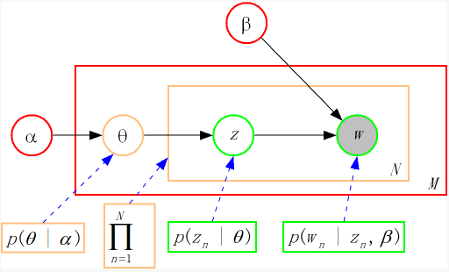
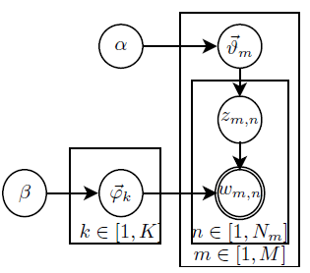
Latent Dirichlet Allocation – Graphical model
Three levels:
Corpus level: α, β (hyper-parameter)
Document level: θ
Vocabulary level: z, w
Latent variable φ – topic-vocabulary
Generative model:
Choose θm ~Dir(α)
Choose zm,n ~ multinomial(θm)
Choose φk ~ Dir(β)
Choose wm,n ~ multinomial(φ*zm,n)

Slide 3
Document Classification
Amazon Food Review

Slide 4
Document Classification：food Review
Take topic number = 5,10,15,20,25,30,50,75
90% for training (1344) and 10% for testing(156)
Compute perplexity

Slide 5
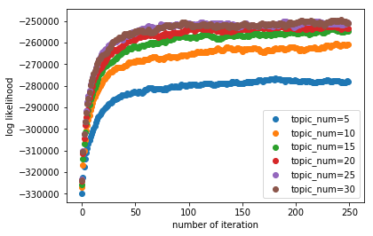
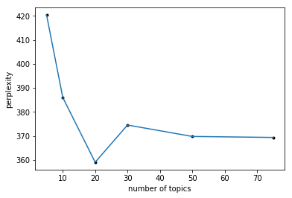
Choose number of Topics

Slide 6
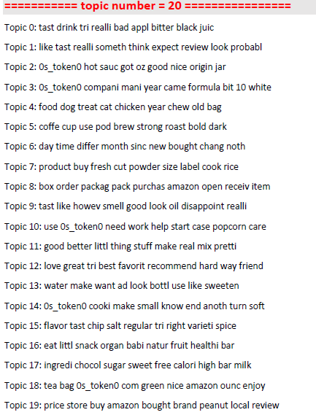
Set Num of Topics = 20

Slide 7
Topics – description
ABOUT PRODUCTS:
Topic 4: food | dog | treat | cat | chicken | year |chew | old | bag
Topic 5: coffee | cup | use | pod | brew | strong | roast | bold | dark
ABOUT SENTIMENT:
Topic 9: taste | like | however | smell | good | look | oil | disappoint | really
Topic 12: love | great | tri | best | favorite | recommend | hard | way | friend
topics | 0 | 1 | 2 | 3 | 4 | 5 | 6 | 7 | 8 | 9 | 10 | 11 | 12 | 13 | 14 | 15 | 16 | 17 | 18 | 19
numbers | 80 | 72 | 60 | 66 | 114 | 126 | 61 | 71 | 97 | 60 | 37 | 47 | 55 | 47 | 34 | 62 | 49 | 79 | 62 | 65

Slide 8
Tag document using top N topics
Find top N (3 or so) topics of each review text, and tag them.
Example:
I'm a cyclist, personal trainer, registered nurse and avid health nut, and I fully endorse these products :) Seriously, they are not only good tasting but follow all the criteria for a healthful snack -- not processes, raw ingredients, not a lot of sugar.
Topic2 (0.149): hot | sauce | got | oz | good | nice | origin | jar health
Topic15(0.113): flavor | tasty | chip | salt | regular | right | variety | spice taste
Topic12(0.077): love | great | tri | best | favorite | recommend | |friend recommend

Slide 9
Sentiment Classification – two Binary
Simplest idea:
Negative ☹ (θ9>θ12) or positive ☺ (θ9<θ12): {'negative': 503, 'positive': 841}
Drawback: however, the ONLY problem, others, ….
SVM:
Score: 1-2: negative; 3-5: positive
Results: 1344 for training and 156 for testing:
Accuracy: 70%(编的，我还在跑)

Slide 10
Sentiment Classification – future work
1. Adjust proportion of data used for training, and compute accuracy
2. Multi-classification: 1-2:negative; 3: neutral; 4-5: positive.
Logistic regression

